Slide 1

Types of Investments

Slide 2
Types of Investments
Stocks
Bonds
Mutual Funds
Real Estate
Savings/Certificates of Deposit
Collectibles

Slide 3
Stocks
An investment that represents ownership in a company or corporation.

Slide 4
How Well the Stock Market is Doing Overall

Slide 5
3 Basic Indicators
Dow Jones Industrial Average (“DOW”)
  Lists the 30 leading industrial blue chip stocks
Standard and Poor’s 500 Composite Index
  Covers market activity for 500 stocks
  More accurate than DOW because it evaluates a greater variety of stock
National Association of Security Dealers Automated Quotations (“NASDAQ”)
  Monitors fast moving technology companies
  Speculative stocks, show dramatic ups and downs

Slide 6

Ups and Downs
The term bull market means the market is doing well because investors are optimistic about the economy and are purchasing stocks
The term bear market means the market is doing poorly and investors are not purchasing stocks or selling stocks already owned

Slide 7
Purchasing Stock

Slide 8
Brokers
A Broker is a person who is licensed to buy and sell stocks, provide investment advice, and collect a commission on each purchase or sale
  Purchases stocks on an organized exchange (stock market)
  Over ¾ of all stocks are bought and sold on an organized exchange

Slide 9
Organized Exchanges
Minimum requirements for a stock to ensure only reputable companies are used
Each exchange has a limited number of seats available which brokerage firms purchase to give them the legal right to buy and sell stocks on the exchange

Slide 10
New York Stock Exchange
New York Stock Exchange (NYSE)
  Oldest and largest, began in 1792
  1,366 seats available
  2,800 companies
  Average stock price is $33.00
  Strict requirements

Slide 11
American Stock Exchange
American Stock Exchange
  Began in 1849
  2nd largest exchange
  It’s requirements are not as strict as NYSE allowing younger, smaller companies to list
  Average stock price is $24.00

Slide 12
Regional Stock Exchanges
Regional Stock Exchanges
  Stocks are traded to investors living in a specific geographical area
    Including Boston, Cincinnati, Philadelphia, Spokane

Slide 13
NASDAQ
National Association of Securities Dealers Automated Quotations
  Stocks are traded in an over the counter electronic market
  4,000 small companies
    Company requirements are not as strict
  More volatile because companies are young and new
  Average stock price is $11.00

Slide 14
Bonds
A security representing a loan of money from a lender to a borrower for a set time period, which pays a fixed rate of interest.
Notes:
Bonds
When you invest in a bond, you effectively lend your money to an organization.
When a bond is issued, it includes a specified maturity date at which
time the principal will be repaid. Bonds are also issued at a particular interest
rate, or what’s known as a coupon. This rate is fixed on most bonds. So,
for example, if you buy a five-year, 6-percent bond issued by Home Depot,
you’re lending your money to Home Depot for five years at an interest rate of
6 percent per year. (Bond interest is usually paid in two equal, semi-annual
installments.)
The value of a bond generally moves opposite of the directional change in
interest rates. For example, if you’re holding a bond issued at 6 percent and
rates increase to 8 percent on comparable, newly issued bonds, your bond
decreases in value. (Why would anyone want to buy your bond at the price
you paid if it yields just 6 percent and 8 percent can be obtained elsewhere?)
Some bonds are tied to variable interest rates. For example, you can buy bonds
that are adjustable-rate mortgages, on which the interest rate can fluctuate.
As an investor, you’re actually lending your money to a mortgage borrower —
indirectly, you’re the banker making a loan to someone buying a home.
Bonds differ from one another in the following major ways:
✓ The type of institution to which you’re lending your money: With
municipal bonds, you lend your money to the state or local government
or agency; with Treasuries, you lend your money to the federal government;
with GNMAs (Ginnie Maes), you lend your money to a mortgage
holder (and the federal government backs the bond); with corporate
bonds, you lend your money to a corporation.
✓ The credit quality of the borrower to whom you lend your money:
This refers to the probability that the borrower will pay you the interest
and return your principal as agreed.
✓ The length of maturity of the bond: Short-term bonds mature within a
few years, intermediate bonds within 3 to 10 years, and long-term bonds
within 30 years. Longer-term bonds generally pay higher yields but
fluctuate more with changes in interest rates.
Bonds are rated by major credit-rating agencies for their safety, usually on a
scale where AAA is the highest possible rating. For example, high-grade corporate
bonds (AAA or AA) are considered the safest (that is, most likely to pay
you back). Next in safety are general bonds (A or BBB), which are still safe but
just a little less so. Junk bonds (rated BB or lower), are actually not all that
junky; they’re just lower in quality and have a slight (1 or 2 percent) probability
of default over long periods of time.
Some bonds are callable, which means that the bond’s issuer can decide to pay
you back earlier than the previously agreed-upon date. This event usually occurs
when interest rates fall and the lender wants to issue new, lower-interest-rate
bonds to replace the higher-rate bonds outstanding. To compensate you for
early repayment, the lender typically gives you a small premium over what
the bond is currently valued at.
Personal Finance for Dummies

Slide 15
Mutual Funds
An investment that pools money from several investors to buy a particular type of investment, such as stocks.
Notes:
Mutual Funds A fund managed by a company that includes a portfolio of stocks or bonds
Risk varies depending on type of mutual fund
PROS
- Diversified
You can select different risk levels
CONS
- Return isn’t guaranteed
- Can be subject to expensive management fees

Slide 16
Real Estate
An investor buys pieces of property, such as land or a building, in hopes of generating a profit.
Notes:
Real Estate
Over the generations, real estate owners and investors have enjoyed rates of return comparable to those produced by the stock market, thus making real estate another time-tested method for building wealth. However, like stocks, real estate goes through good and bad performance periods. Most people who make money investing in real estate do so because they invest over many years and do their homework when they buy to ensure that they purchase good property at an attractive price.
Buying your own home is the best place to start investing in real estate. The equity (the difference between the market value of the home and the loan owed on it) in your home that builds over the years can become a significant part of your net worth. Among other things, this equity can be tapped to help finance other important money and personal goals, such as retirement, college, and starting or buying a business. Moreover, throughout your adult life, owning a home should be less expensive than renting a comparable home.
When you want to invest directly in real estate, residential housing — such as single-family homes or small multi-unit buildings — may be an attractive investment. Buying properties close to home offers the advantage of allowing you to more easily monitor and manage what’s going on. The downside is that you’ll be less diversified — more of your investments will be dependent on the local economy.
If you don’t want to be a landlord — one of the biggest drawbacks of investment real estate — consider investing in real estate through real estate investment trusts (REITs). REITs are diversified real estate investment companies that purchase and manage rental real estate for investors. A typical REIT invests in different types of property, such as shopping centers, apartments, and other rental buildings. You can invest in REITs either by purchasing them directly on the major stock exchanges or by investing in a real estate mutual fund that invests in numerous REITs.
Personal Finance for Dummies

Slide 17
Savings/Certificates of Deposits
A deposit that earns a fixed interest rate for a specified length of time.
  The longer the time period the greater the rate of return.
  There is a substantial penalty for early withdrawal.
Notes:
A bank is one of the safest places to stash your cash. In the wake of the financial crisis of 2008, the federal government increased the level of insurance on bank accounts -- it's now $250,000 per depositor.
Banks pay lower rates on interest-bearing accounts than brokerages and mutual fund companies that offer check-writing privileges. What's more, bank fees can be high -- account costs can easily add up to $200 a year or more unless you keep a minimum required balance on deposit.
Even at a low rate of inflation, the annual creep in the cost of goods and services usually outpaces what banks pay in interest-bearing accounts.
Certificates of deposit (CDs) offer some of the best guaranteed rates on your money and are insured up to $250,000 each.
The catch: you have to lock up your money for three months to five years or more. If interest rates fall before the CD expires, the bank is out of luck and must give you the rate it quoted. If rates climb, you're stuck with the lower rate.
Also with rising interest rates, money market accounts can become an attractive option, too. They pay more than banking accounts and you don't have to lock up your money for a specific amount of time.

Slide 18
Collectibles
Unique items that are relatively rare or highly valued.
  Art work
  Baseball trading cards
  Coins
  Automobiles
  Antiques
Notes:
Collectibles
The collectibles category is a catchall for antiques, art, autographs, baseball cards, clocks, coins, comic books, diamonds, dolls, gems, photographs, rare books, rugs, stamps, vintage wine, and writing utensils — in other words, any material object that, through some kind of human manipulation, has become more valuable to certain humans.
Notwithstanding the few people who discover on the Antiques Roadshow that they own an antique of significant value, collectibles are generally lousy investment vehicles. Dealer markups are enormous, maintenance and protection costs are draining, research is time-consuming, and people’s tastes are quite fickle. All this for returns that, after you factor in the huge markups, rarely keep up with inflation. Furthermore, investment gains you do earn on collectibles are taxed at a higher federal tax rate (28 percent) than capital gains on stocks, real estate, and small business (15 percent).
Buy collectibles for your love of the object, not for financial gain. Treat collecting as a hobby, not as an investment. When buying a collectible, try to avoid the big markups by cutting out the middlemen. Buy directly from the artist or producer if you can.
Personal Finance for Dummies

Slide 19
Risk vs. Return
On average, stocks have a high rate of return
  The increase or decrease in the original purchase price of an investment
Higher rate of return = greater risk
  Uncertainty about the outcome of an investment
Stocks provide portfolio diversification
  Money invested in a variety of investment tools

Slide 20
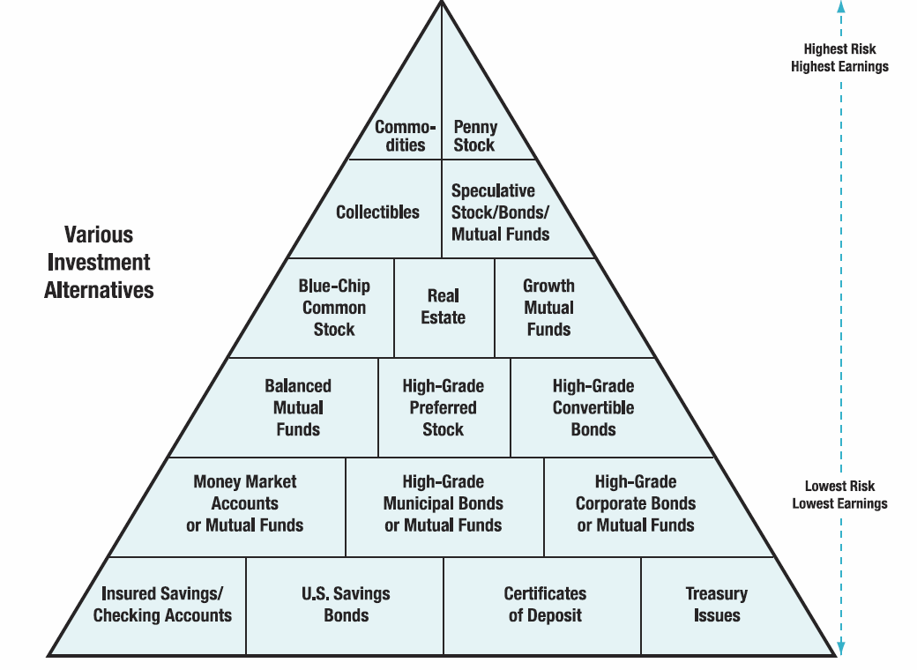
Notes:
http://hsfpp.nefe.org/instructors/channels.cfm?chid=88&tid=1&deptid=22
NEFE Unit 3 Student Guide

Slide 21
Short-term Investment Strategies
Buying on margin is where an investor borrows part of the money needed to invest in a stock from a brokerage firm.
  There is a 50% margin requirement.
  If you want to purchase $2,000 worth of stock you can borrow up to $1,000 to make the purchase.

Slide 22
Short-term Investment Strategies
Short selling is where an investor sells shares of stock that they don’t own with the intent to buy them back later at a lower price.
  Let’s use rollerblades as an example.

Slide 23

Your friend buys new rollerblades for $80.
You borrow them and sell them for $80.
The price at the stores has been lowered to $45.
You buy a new pair for $45 and give them to your friend.
You made $35!!!

Slide 24
Long-term Investment Strategies
Diversification is spreading your assets among different types of investments to reduce risk.
  Don’t put all your eggs in one basket.

Slide 25
Long-term Investment Strategies
Dollar Cost Averaging is buying an equal amount of the same stock at equal intervals.
  Invest $100 in e-bay every month. The price you pay for the stock averages out over time.

Slide 26
Long-term Investment Strategies
Buy and hold technique is where an investor buys stock and holds on to it for a number of years.
  During that time you are paid dividends and the price of the stock may go up.

Slide 27
How Can Government Regulations Protect Investors?
Regulatory Pyramid
  A network of safeguards that surrounds the securities industry - from individual brokerages all the way up to the U.S. Congress.

Slide 28

Regulatory Pyramid
www.nyse.com

Slide 29
Sources of Investment Information
Prospectus
  A formal written offer to sell securities that sets forth a plan for a proposed business enterprise. A prospectus should contain the facts that an investor needs to make an informed decision.

Slide 30
Sources of Investment Information
Annual report
  A document detailing the business activity of a company over the previous year, and containing an income statement, cash flow statement, and balance sheet.

Slide 31
Sources of Investment Information
Financial publications
  Wall Street Journal
  Fortune
  Kiplingers Personal Finance
Online information
  http://finance.yahoo.com
  http://moneycentral.msn.com

Slide 32
How Do You Buy and Sell Investments?
Full-service broker
Discount broker
Online broker
Investment advisors
Notes:
Full-service brokers
Cost: Commissions are typically based on a percentage of your purchase (or sale) price.
Discount brokers
Cost: Between $10 and $20 for a trade of 1,000 shares or less, and on average, discounters charge one-third the price of full-service brokers.
Online brokers
Cost: At $9 to $15 a trade, it doesn't get any cheaper than this.

